Slide 1
Arc Python Programming

Slide 2
Find a layer
import arcpy
# Get the current project
project = arcpy.mp.ArcGISProject("CURRENT")
# Set the name of the map and layer you want to find
map_name = "YourMapName"
layer_name = "YourLayerName"
# Get the map
map = project.listMaps(map_name)[0]
# Find the layer by name
layer = None
for lyr in map.listLayers():
if lyr.name == layer_name:
layer = lyr
break
if layer:
print(f"Layer '{layer_name}' found: {layer}")
else:
print(f"Layer '{layer_name}' not found.")

Slide 3
Remove a layer
import arcpy
# Get the current project
project = arcpy.mp.ArcGISProject("CURRENT")
# Names
map_name = "YourMapName"
layer_name = "YourLayerName"
# Get the map
m = project.listMaps(map_name)[0]
# Find the layer by name (first match)
layer_to_remove = None
for lyr in m.listLayers():
if lyr.name == layer_name:
layer_to_remove = lyr
break
# Remove it
if layer_to_remove:
m.removeLayer(layer_to_remove)
print(f"Removed layer: {layer_name}")
else:
print(f"Layer '{layer_name}' not found.")

Slide 4
Queries in terms of certain conditions
import arcpy
# Get the current project
project = arcpy.mp.ArcGISProject("CURRENT")
# Set the name of the map and layer you want to find
map_name = "Map"
layer_name = "LANDUSE"
# Get the layer
mp = project.listMaps(map_name)[0]
lyr = mp.listLayers()[0]
# where clause
where = "LU = 300 AND AREA > 100"
# Apply selection
arcpy.management.SelectLayerByAttribute(lyr, "NEW_SELECTION", where)

Slide 5
Cont’d
# Print count
sel_count = int(arcpy.management.GetCount(lyr)[0])
print("Selected parcels:", sel_count)
# Display IDs (ObjectIDs) of the selected features
# Using lyr directly will respect the current selection
oids = []
with arcpy.da.SearchCursor(lyr, ["OID@"]) as cur:
for (oid,) in cur:
oids.append(oid)
print("Selected OIDs:")
print(oids)

Slide 6
Reclassify a field – single factor evaluation
import arcpy
def get_lufield(table):
fields = arcpy.ListFields(table)
for field in fields:
if field.name == "LU":
return field
def get_lusuit(table):
fields = arcpy.ListFields(table)
for field in fields:
if field.name == "LU_suit":
return field

Slide 7
Cont’d
def changefldvalue(lulayer, lufield, suitfield):
# Create the search cursor
cursor = arcpy.UpdateCursor(lulayer)
# Iterate through the rows in the cursor
for row in cursor:
if row.getValue(lufield.name)==100:
row.setValue(suitfield.name, 5)
else:
row.setValue(suitfield.name, 3)
cursor.updateRow(row)
#return 1

Slide 8
Cont’d
project = arcpy.mp.ArcGISProject("CURRENT")
map_name = "Map" # Change to your map name
# Get the map and layer
map = project.listMaps(map_name)[0]
layer_name = "LANDUSE" # Change to your layer name
lyr = map.listLayers(layer_name)[0]
lufld= get_lufield(lyr)
suitfld = get_lusuit(lyr)
arcpy.AddMessage("Proceed to field value change...")
changefldvalue(lyr, lufld, suitfld)

Slide 9
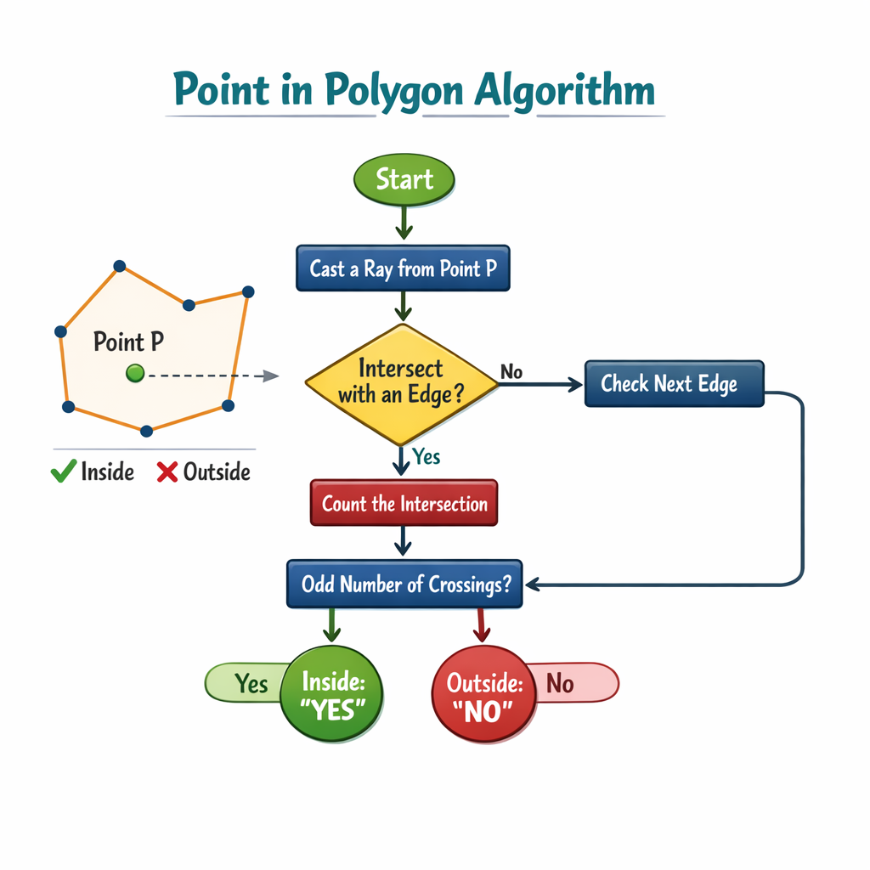
Point in polygon

Slide 10
def is_point_in_polygon(point, polygon):
"""
Determine if a point is inside a polygon using ray casting.
Parameters:
point (tuple): (x, y) coordinates of the point.
polygon (list): List of (x, y) tuples representing polygon vertices.
Returns:
bool: True if point is inside polygon, False otherwise.
"""
x, y = point
inside = False
n = len(polygon)
for i in range(n):
x1, y1 = polygon[i]
x2, y2 = polygon[(i + 1) % n] # next vertex (wrap around)
# Check if point is between y1 and y2
if ((y1 > y) != (y2 > y)):
# Compute x-coordinate of intersection with polygon edge
x_intersect = (x2 - x1) * (y - y1) / (y2 - y1 + 1e-12) + x1
if x < x_intersect:
inside = not inside
return inside

